Slide 1

Work-let Name: Auto Response generation using Generative AI for Call Scenario
Worklet Details
Worklet ID: 23VI30SRM
College Name: SRM Institute of Science and Technology
KPIs achieved till now
Any Challenges/ Issues faced
Response Quality Assessment
Emotional Response Generation
Commonsense Knowledge Integration
Dataset Utilization Efficiency
Dataset Imbalance
Emotion Grounding Complexity
Contextual Emotion Understanding
Fine-tuning Complexity
Evaluation Metric Suitability
Next Steps
Key Achievements/ Outcome till now
Emotion-Context Alignment Refinement:
Dataset Augmentation and Balancing:
User Feedback Incorporation, Fine-tuning Optimization
Ethical Considerations and Bias Mitigation
Deployment and Real-world Testing
Continual Model Maintenance and Updates
Quality Improvement in Responses
Refined Emotional Alignment:
Emotion-Centric Dataset Enrichment
Emotional Diversity Benchmarking
Robust Dataset Creation Methodology
Date: 14/12/23

Slide 2
KPIs Achieved Till Now
Worklet ID: 23VI30SRM
College Name: SRM Institute of Science and Technology
Response Quality Assessment:
Human Evaluation Scores: To assess the quality of the generated responses in terms of consistency, specificity and naturalness.
Performance Metrics: BLEU score, ROUGE score, or other automatic evaluation metrics to gauge the similarity and coherence of the generated responses with the input context.
Emotional Response Generation:
Emotional Classification Accuracy: Measured the accuracy of predicting emotional reactions in responses generated by the AI model using the emotional labels
Commonsense Knowledge Integration:Quantified the reduction in nonsensical or irrelevant conversations by anchoring the AI model with commonsense knowledge from the symbolic commonsense knowledge graph.
Resource Optimization: Ensured optimal usage of the dataset to maximize the performance of the AI model.

Slide 3
Any Challenges/ Issues faced
Dataset Imbalance: Managing imbalances in the distribution of emotional labels within the Allenai dataset posed a challenge.
Emotion Grounding Complexity: Ensuring accurate grounding of diverse emotional states to conversational contexts was challenging.
Contextual Emotion Understanding: Teaching the model to understand and appropriately respond to subtle contextual emotional cues within conversations presented a challenge.
Fine-tuning Complexity: Fine-tuning large language models like T5 for emotional diversity demands extensive computational resources and time.
Evaluation Metric Suitability: Selecting appropriate evaluation metrics to assess emotional diversity accurately was challenging.
Worklet ID: 23VI30SRM
College Name: SRM Institute of Science and Technology

Slide 4
Next Steps
Emotion-Context Alignment Refinement:
Further refine the fine-tuned model to better align emotional expressions with diverse contextual
Dataset Augmentation and Balancing:
Augment the dataset to address emotional label imbalances, enriching the model's understanding of less frequent emotional states and enhancing the diversity of emotional expressions in responses.
User Feedback Incorporation, Fine-tuning Optimization:
Gather and incorporate real-time user feedback to iteratively improve the model's ability.
Ethical Considerations and Bias Mitigation:
Conduct comprehensive evaluations to identify and mitigate biases within the model's responses, ensuring fairness and ethical handling of emotional expressions in diverse call scenarios.
Deployment and Real-world Testing:
Deploy the enhanced model in a controlled real-world environment to validate its effectiveness
Continual Model Maintenance and Updates:
Implement a robust maintenance strategy, including regular model updates, re-fine-tuning cycles, and adaptation to evolving call context and user requirements.
Worklet ID: 23VI30SRM
College Name: SRM Institute of Science and Technology

Slide 5
Key Achievements/Outcome Till Now
Quality Improvement in Responses:
Demonstrated significant improvements in response quality metrics, including enhanced human evaluation scores and performance metrics
Refined Emotional Alignment:
Achieved refined alignment of emotional expressions with diverse contextual cues within the dataset, thereby enhancing overall conversational quality in call scenarios.
Emotion-Centric Dataset Enrichment:
Curated and labeled 385K conversations with 1.7K unique emotions in accompanied by detailed information about the experiencer and the causal event, providing an extensive resource for emotional response generation.
Emotional Diversity Benchmarking:
Successfully achieved diverse emotional expressions across a wide range of emotional states within AI-generated responses.
Robust Dataset Creation Methodology:
Developed a comprehensive methodology to distill dialogues from InstructGPT, contextualizing social commonsense knowledge in multiple stages.
Worklet ID: 23VI30SRM
College Name: SRM Institute of Science and Technology

Slide 6
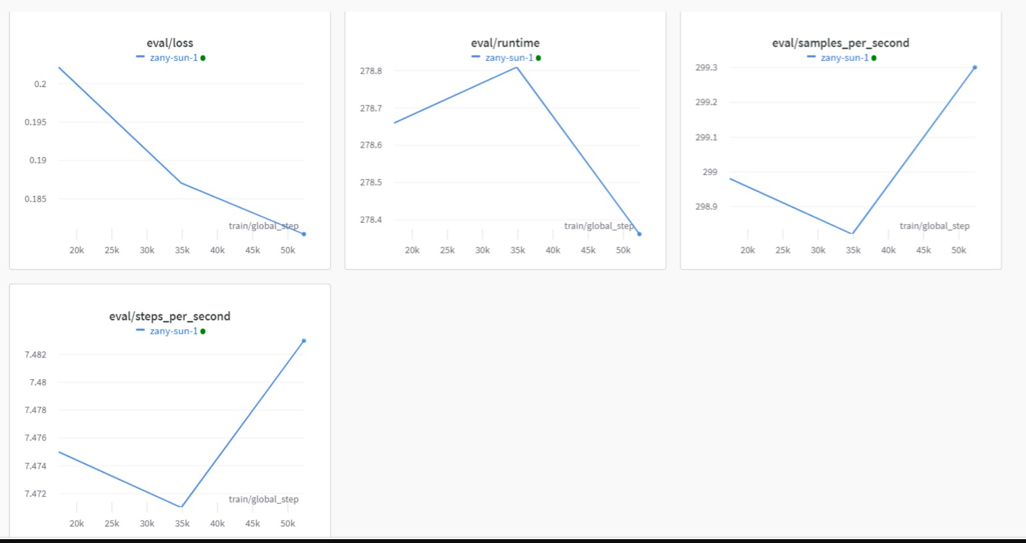
OUTPUT SCREENSHOT-GRAPH
Worklet ID: 23VI30SRM
College Name: SRM Institute of Science and Technology

Slide 7
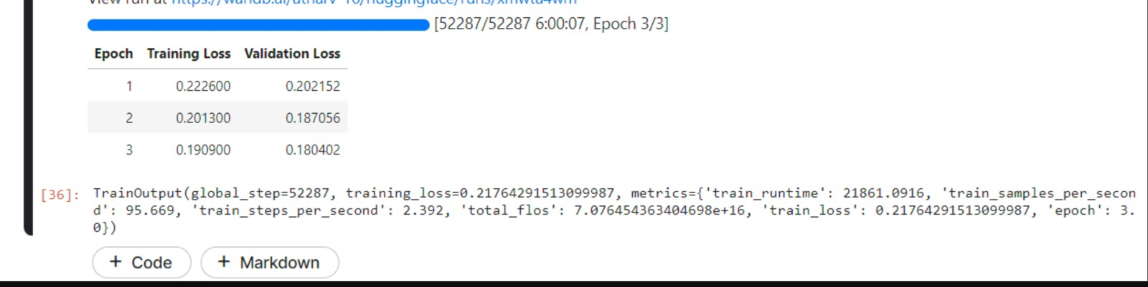
OUTPUT SCREENSHOT-CODE ANALYSIS
Worklet ID: 23VI30SRM
College Name: SRM Institute of Science and Technology

Slide 8
CONCLUSION
The project epitomizes a monumental stride in AI-driven conversational prowess, harnessing a model trained on an extensive 1.19M parameters.
Embracing the dataset, its core focus on response quality, emotional intelligence, and commonsense integration fosters transformative dialogues.
With a meticulous validation of 149K parameters and rigorous testing encompassing 146K parameters, this endeavour signifies a transformative leap towards crafting human-like, emotionally rich responses in call scenarios, ushering in a new era of sophisticated conversational AI.
Worklet ID: 23VI30SRM
College Name: SRM Institute of Science and Technology

Slide 9

Worklet ID: 23VI30SRM
College Name: SRM Institute of Science and Technology

